Slide 1

WEST NILE VIRUS PREDICTIONS
Prakash, Kevin, Chia ,Sim Yi

Slide 2
Contents
Overview
Problem Statement
Data Cleaning
EDA
Feature Engineering
Models
Limitations and further research
Cost Benefit Analysis
Conclusion
Recommendations

Slide 3
Overview
West Nile Virus is most commonly spread to humans through infected mosquitos. Around 20% of people who become infected with the virus develop symptoms ranging from a persistent fever, to serious neurological illnesses that can result in death.

Slide 4
Problem Statement
To develop a predictive model that will forecast the probability of WNV presence in 138 mosquito traps around Chicago over the course of a season. We would also be analysing the cost-benefit analysis of spraying to mitigate the effects of the WNV being spread from mosquitoes.

Slide 5

Data
Weather
Train
Spray
Collection of weather data from 2 weather station located at airport.
Data range from 2007 - 2014
Odd year data (2007, 2009, 2011, 2013) of location of trap and whether the virus is detected in the mosquito caught
2011 & 2013 data of the located of the spray

Slide 6
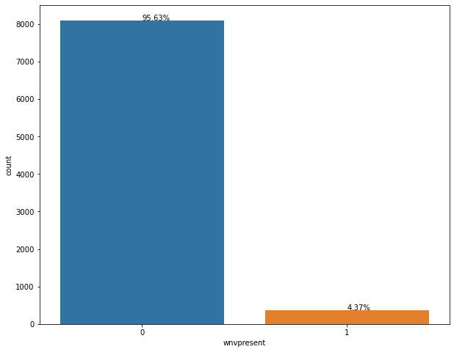
Frequency of wnvpresent in our data

Slide 7
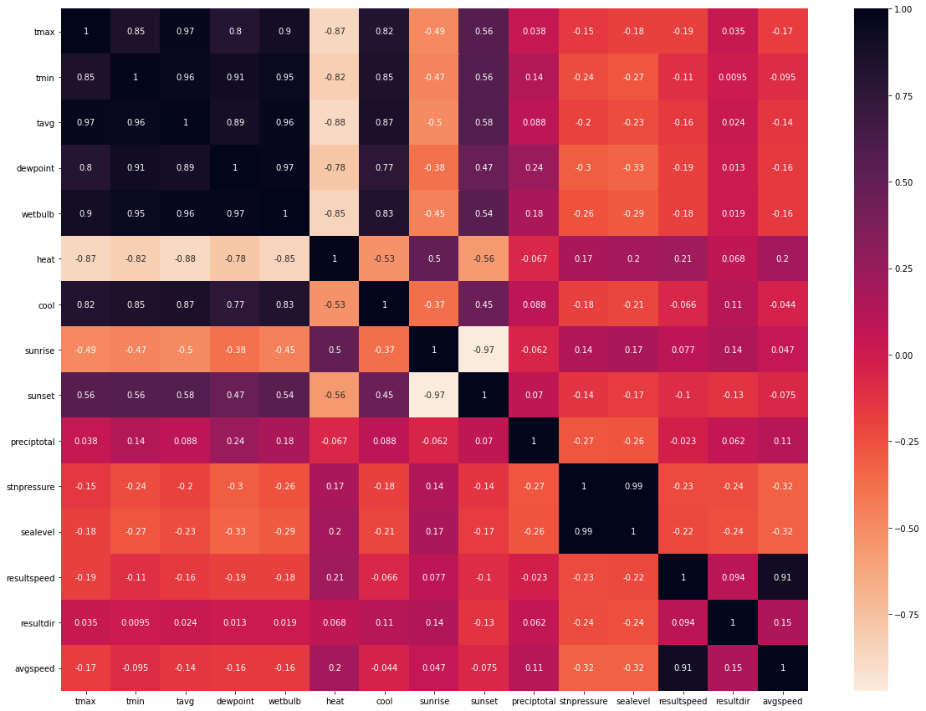
Correlation Heatmap of variables of interest

Slide 8
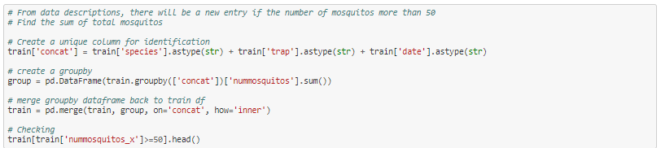
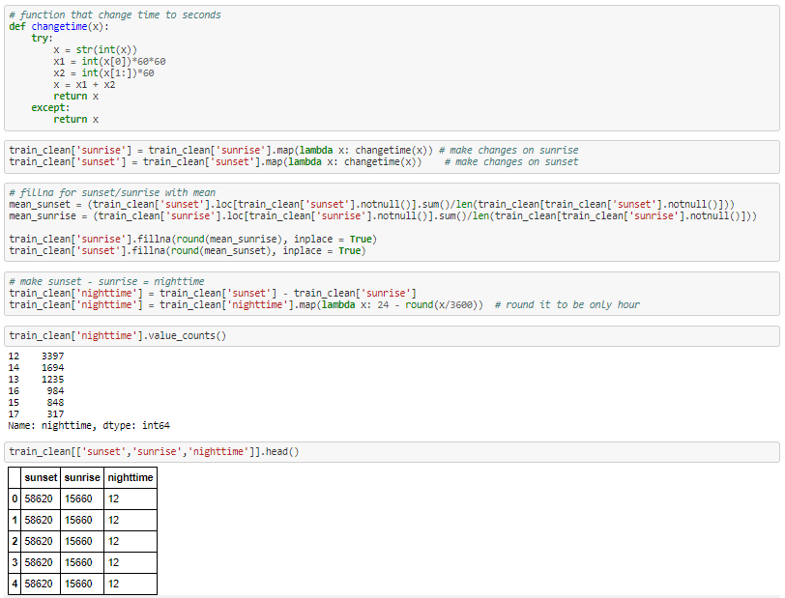
Data Cleaning
Removal of null values (‘M’, ‘-’, ‘T’):
Preciptotal, etc
Dropping of columns which exhibits high collinearity/non-deterministic to our model:
Heat, dewpoint, tmin, tmax, addressaccuracy, etc
Creation of new features:
Total Mosquitos
Nighttime

Slide 9
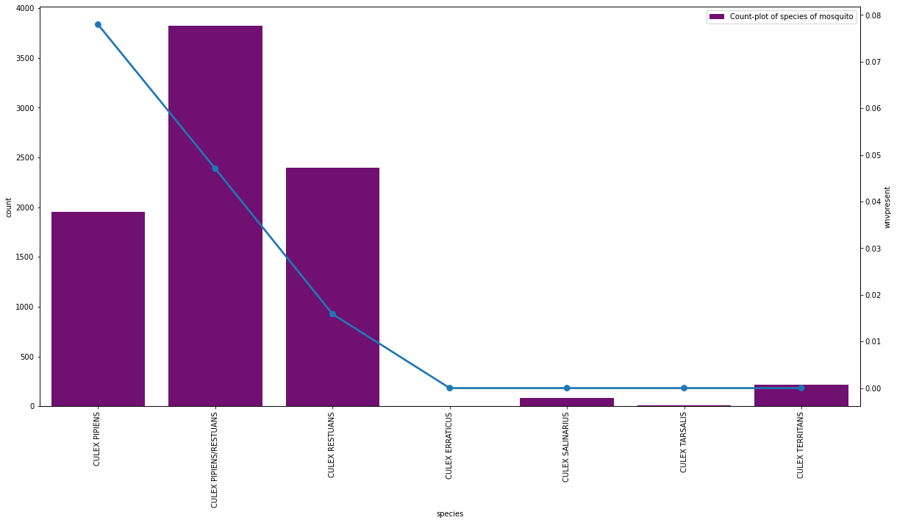
Wnvpresent by species - frequency

Slide 10
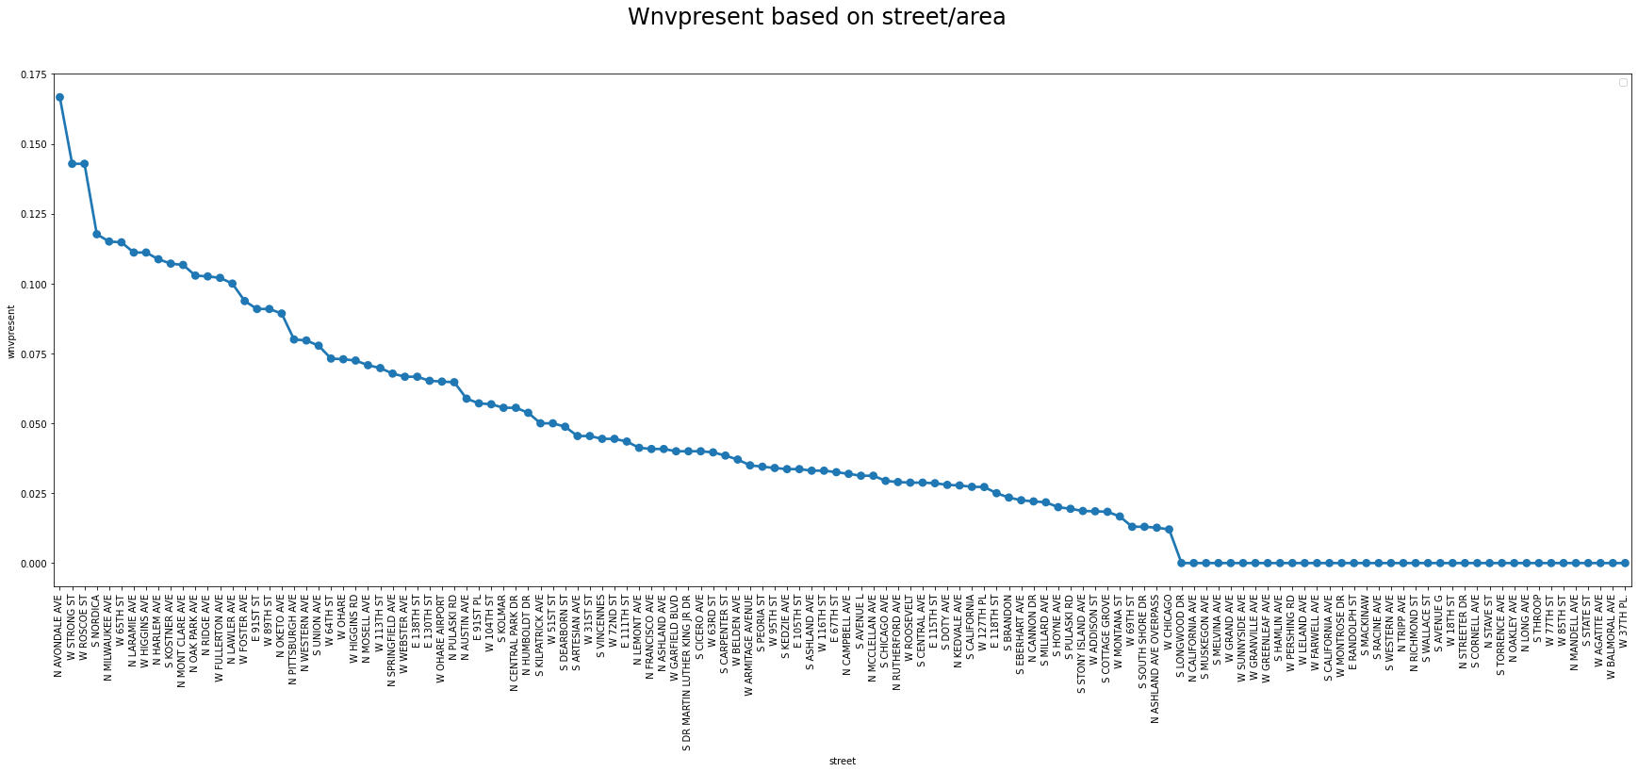
Wnvpresent by street/area - scaled and sorted

Slide 11
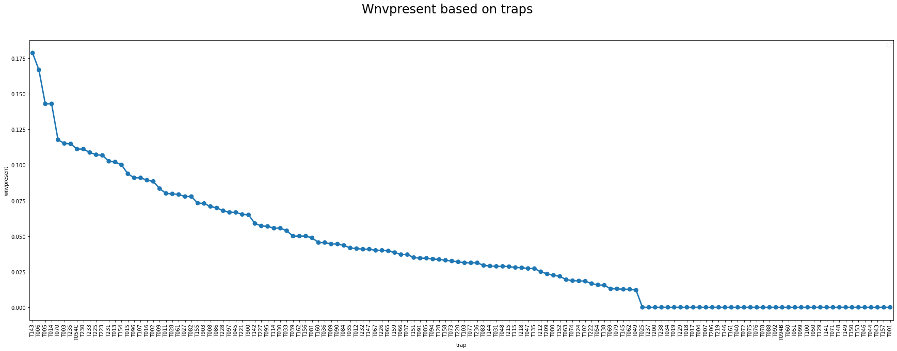
Wnvpresent by traps - scaled and sorted

Slide 12
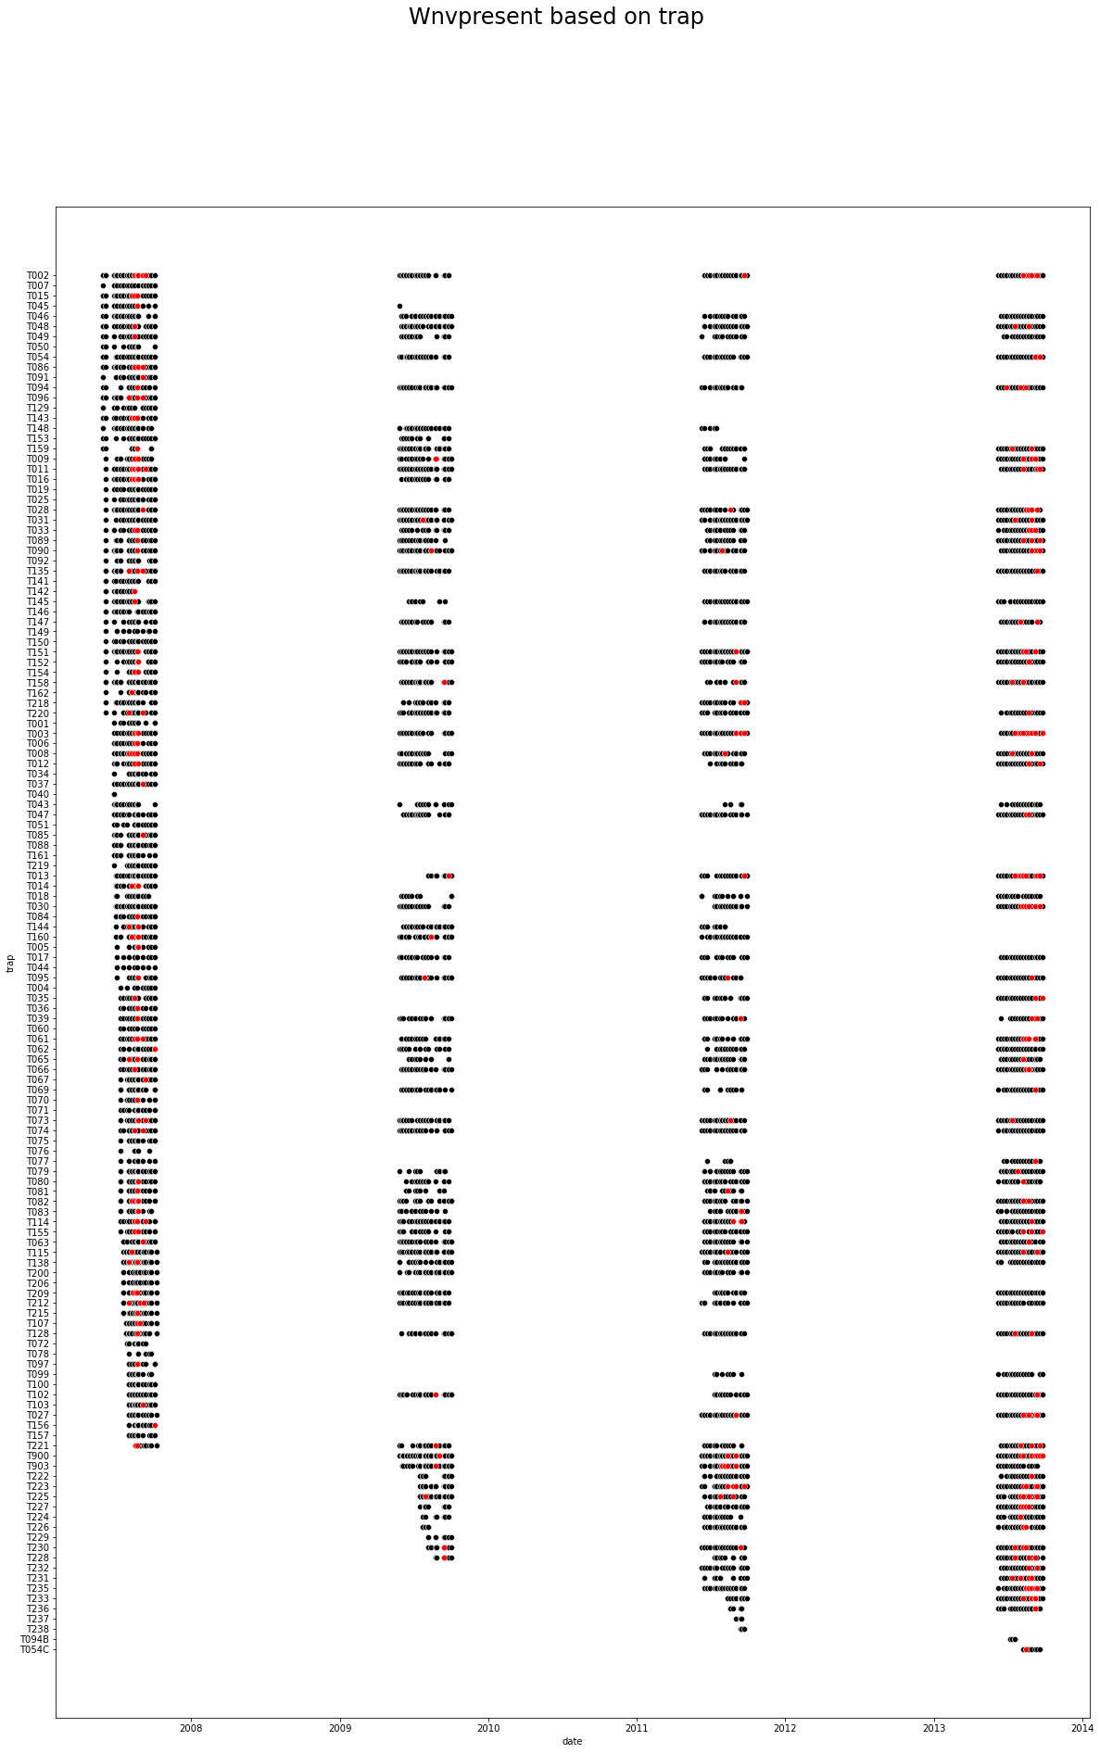
Wnvpresent by traps - by Year
** figure represents only a small subset of full data
2007
2009
2011
2013
Inconsistent testing across the years
New traps added over the years
Almost all traps in 2007 and 2013 had presence of WNV

Slide 13
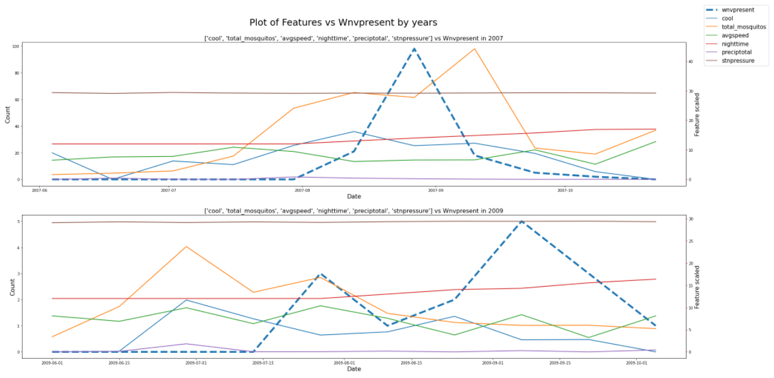
Relationship of features vs Wnvpresent (2007 & 2009)

Slide 14
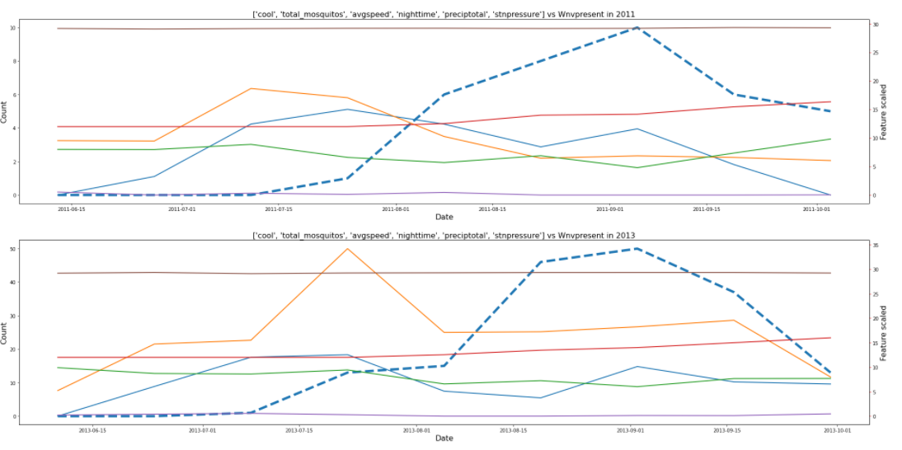
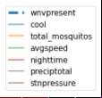
Relationship of features vs Wnvpresent (2011 & 2013)

Slide 15
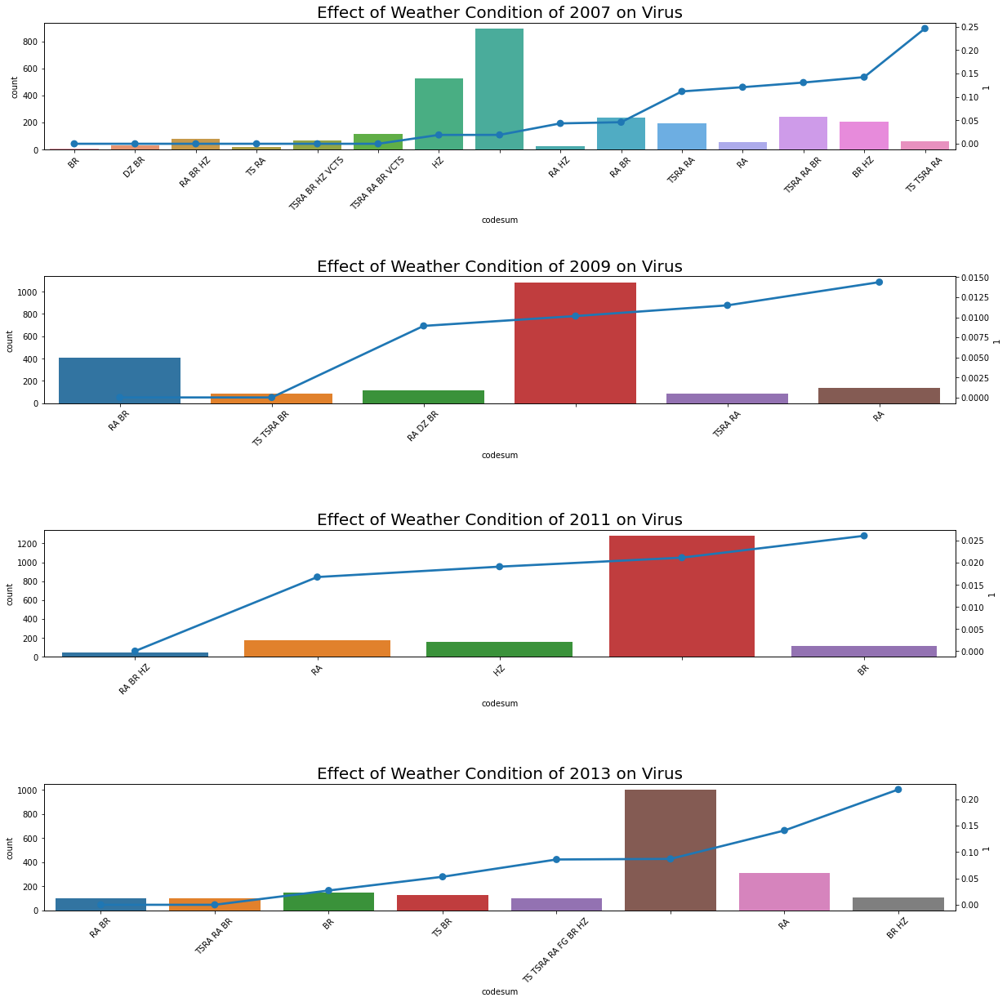
Effect of Weather Condition on WnvPresent (2007 & 2009)

Slide 16
Effect of Weather Condition on WnvPresent (2011 & 2013)

Slide 17
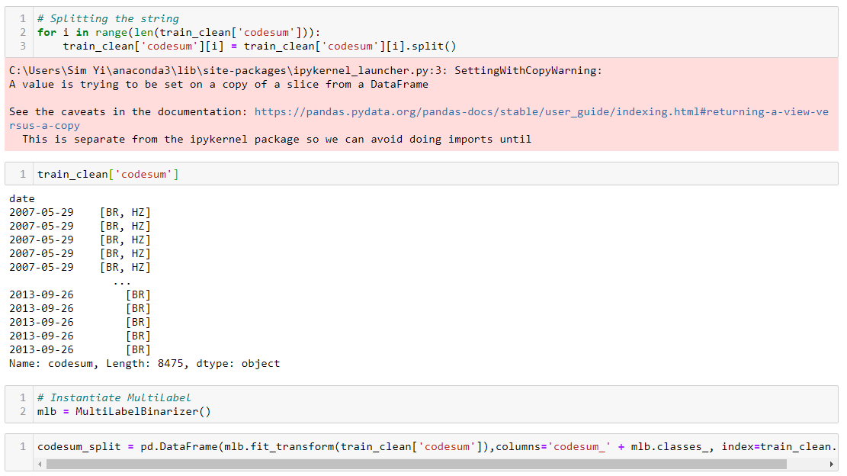
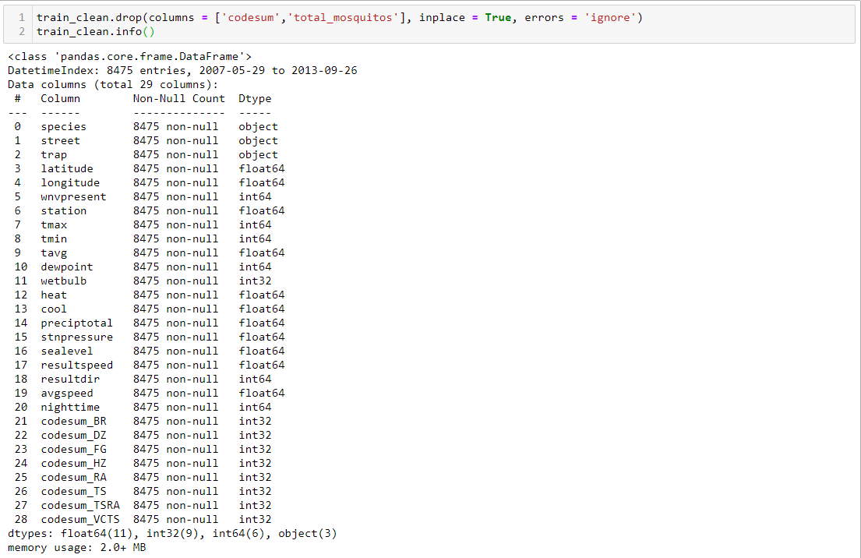
Feature Engineering
Multi-Binarize of data:
Codecum [weather condition]

Slide 18
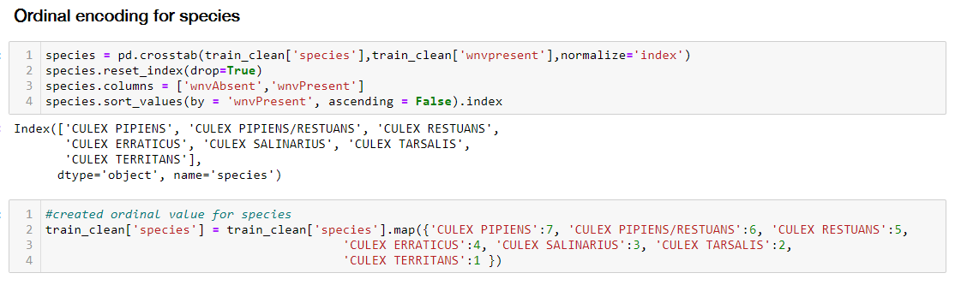
Feature Engineering
Ordinal Encoding:
Species

Slide 19
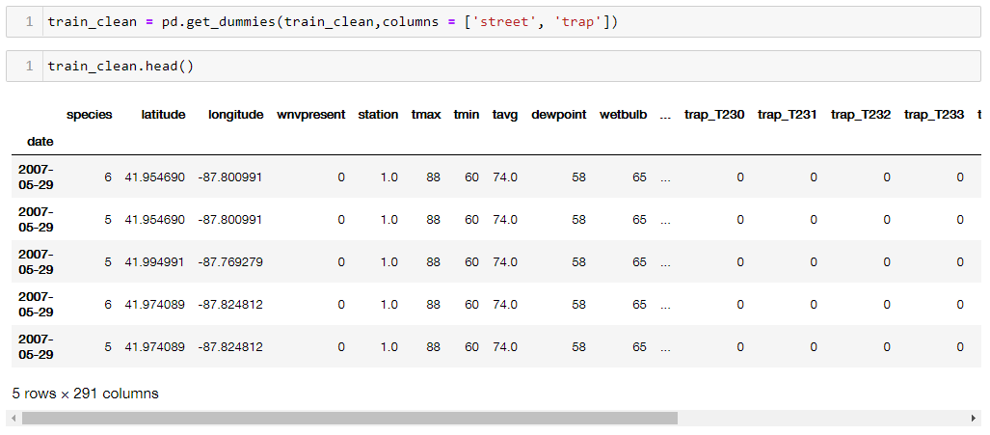
Feature Engineering
One Hot Encoding:
Street
Traps

Slide 20

Models
Random Forest
XGBoost
AdaBoost

Slide 21
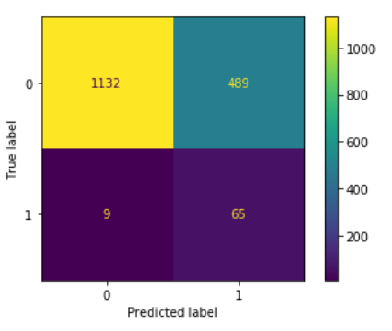
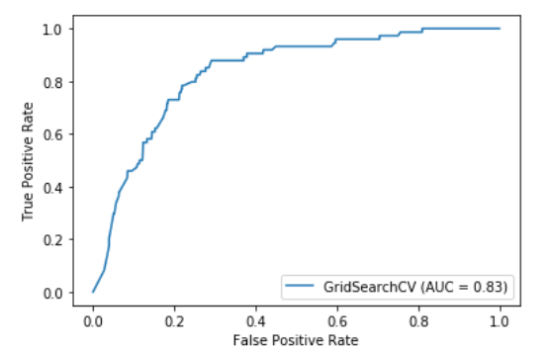
Models - RandomForest
Best Param :
sampling_k_neighbors: 10, RF_max_depth: 4, RF_max_leaf_nodes: 5, RF_n_estimators: 20
MCC score: 0.2512
Accuracy score: 0.8349

Slide 22
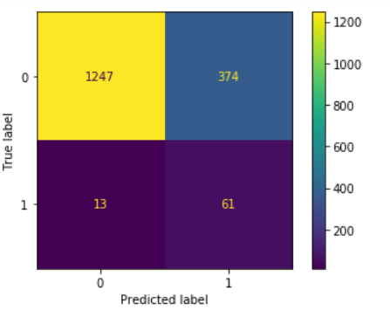
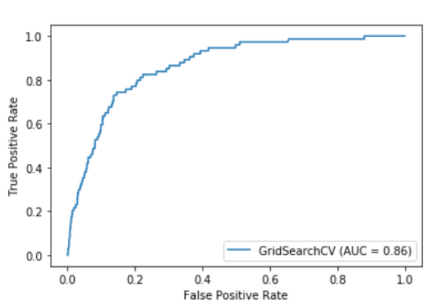
Models - XGBoost
Best Param :
sampling_k_neighbors: 10, xgb_learning_rate: 0.05, xgb_max_depth: 5, xgb_n_estimators: 50, xgb_subsample: 0.8, xgb_verbosity: 0
MCC score: 0.2777
Accuracy score: 0.8645

Slide 23
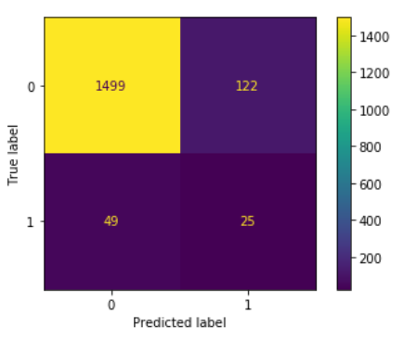
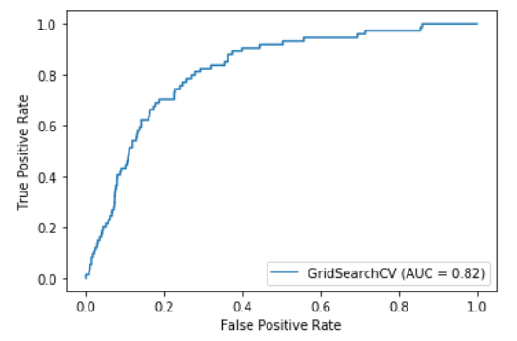
Models - AdaBoost
Best Param :
sampling_k_neighbors: 10, ada_learning_rate: 1, ada_n_estimators: 150
MCC score: 0.1906
Accuracy score: 0.8188

Slide 24
Models Comparison
RandomForest | XGBoost | ADAboost
ROC AUC: 0.83 MCC: 0.2152 | ROC AUC: 0.86 MCC: 0.2777 | ROC AUC: 0.82 MCC: 0.1906

Slide 25
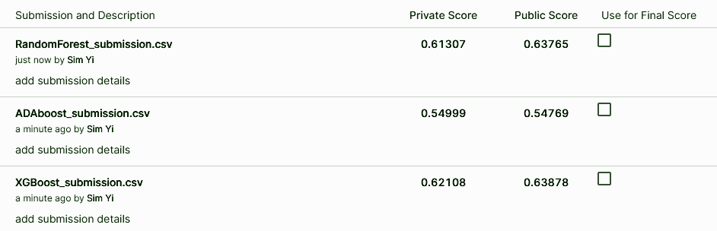
Final Score

Slide 26
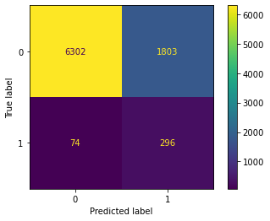
Cost Benefit Analysis
Total Medical Cost = $12.2M
Total Cost of spray based on model = $42K
Potential Saving = $9.7M
Total Medical Cost of False Neg = 2.5M + ϵ
Total Cost of spay of False Neg = $1.5K
Assumption:
Cost of spray per case = $20
Medical cost per case = $33,413
+ ϵ - intangible costs (public backlash, loss of reputation to city council, etc.)

Slide 27
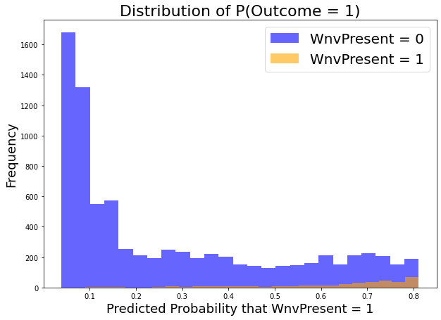
Conclusion
There is a slight upward trend in the presence of west nile virus at >60% probability.
Recommendation is for local authorities to focus additional efforts on preventive measures where areas are predicted to have at least 60% probability of having West Nile Virus.
Further preventive measure in conjunction with the spray will highly reduce the cases of West Nile Virus

Slide 28
Recommendations
The study of seasonal weather patterns on mosquito behaviour
Understanding how WNV is transmitted through mosquitoes
Have more training data
Targeted mosquito spraying and data collection efforts

Slide 29
Thanks!
]]

